Slide 1
Intelligent Cloud Operations Part 5. Distributed Trace Analysis
Definition (Gartner) [AIOps]
AIOps platforms utilize big data, modern machine learning and other advanced analytics technologies to directly and indirectly enhance IT operations (monitoring, automation and service desk) functions with proactive, personal and dynamic insight.
Prof. Jorge Cardoso
E-mail: jorge.cardoso@huawei.com
Intelligent Cloud Operations/SRE Dept.
Ireland and Munich Research Centers
2020
Notes:
Presentation adapted from the previous presentation:
AIOps: Anomaly Detection of Distributed Traces, National University of Ireland, Galway (NUI Galway), 2019.08.20
AIOps-driven Anomaly Detection in microservice architectures, ICT Autonomous Network O&M Conference
2019.06.27, Dublin, Ireland

Slide 2
OpenStack Troubleshooting
Troubleshooting
Using logs, traces, metrics, events, alarms, etc.
https://docs.openstack.org/install-guide/get-started-logical-architecture.html

Slide 3
Troubleshooting Monitoring Data Sources
System’s Components (e.g., OBS, EVS, VPC, ECS) are monitored and generate various types of data: Logs, Metrics, Traces, Events, Topologies
Logs. Service, microservices, and applications generate logs, composed of timestamped records with a structure and free-form text, which are stored in system files.
Metrics. Examples of metrics include CPU load, memory available, and the response time of a HTTP request.
Traces. Traces records the workflow and tasks executed in response to, e.g., an HTTP request.
Events. Major milestones which occur within a data center can be exposed as events. Examples include alarms, service upgrades, and software releases.
Topology. --
2017-01-18 15:54:00.467 32552 ERROR oslo_messaging.rpc.server [req-c0b38ace - default default] Exception during message handling
{“tags": [“mem”, “192.196.0.2”, “AZ01”], “data”: [2483, 2669, 2576, 2560, 2549, 2506, 2480, 2565, 3140, …, 2542, 2636, 2638, 2538, 2521, 2614, 2514, 2574, 2519]}
{"traceId": "72c53", "name": "get", "timestamp": 1529029301238, "id": "df332", "duration": 124957, “annotations": [{"key": "http.status_code", "value": "200"}, {"key": "http.url", "value": "https://v2/e5/servers/detail?limit=200"}, {"key": "protocol", "value": "HTTP"}, "endpoint": {"serviceName": "hss", "ipv4": "126.75.191.253"}]
{"id": "dns_address_match“, "timestamp": 1529029301238, …}
{"id": "ping_packet_loss“, "timestamp": 152902933452, …}
{"id": "tcp_connection_time“, "timestamp": 15290294516578, …}
{"id": "cpu_usage_average “, "timestamp": 1529023098976, …}

Slide 4
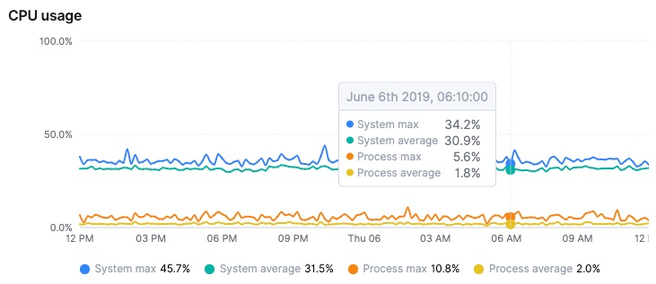
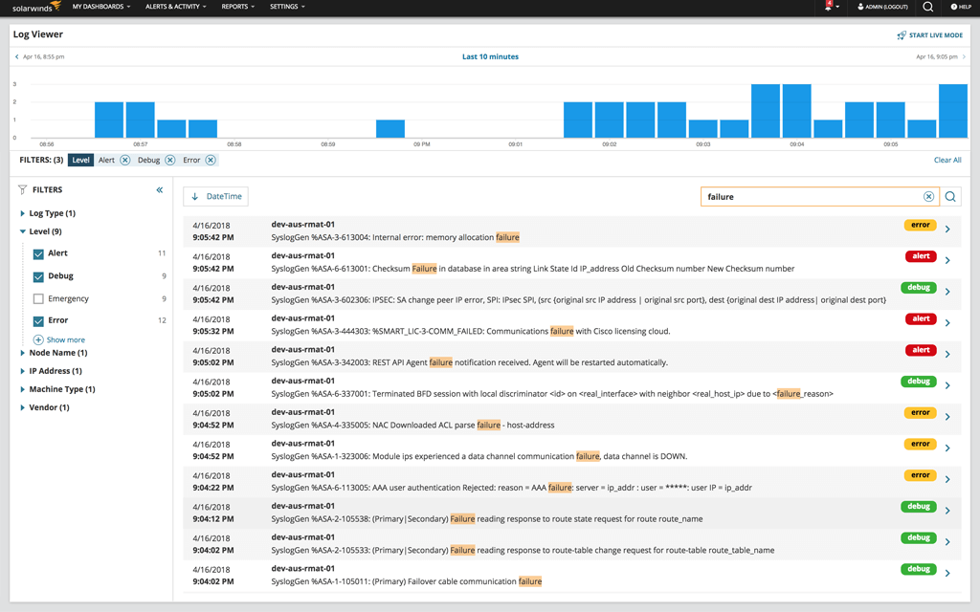
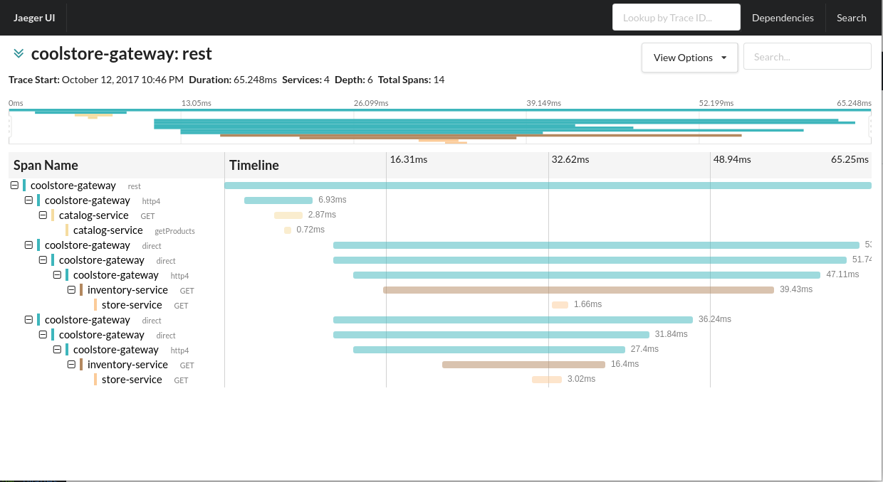
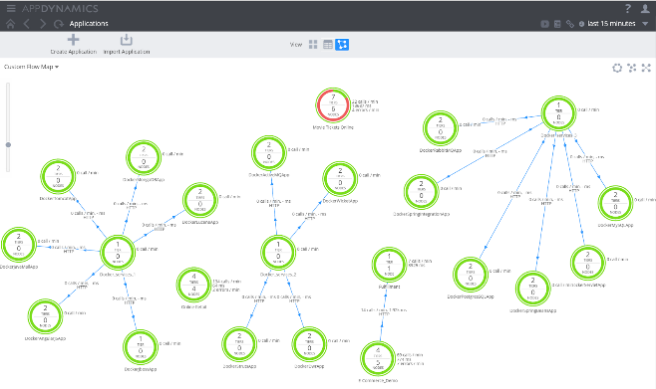
Troubleshooting Monitoring Data Sources
Metric analysis
Log analysis
Trace analysis
Topology analysis

Slide 5
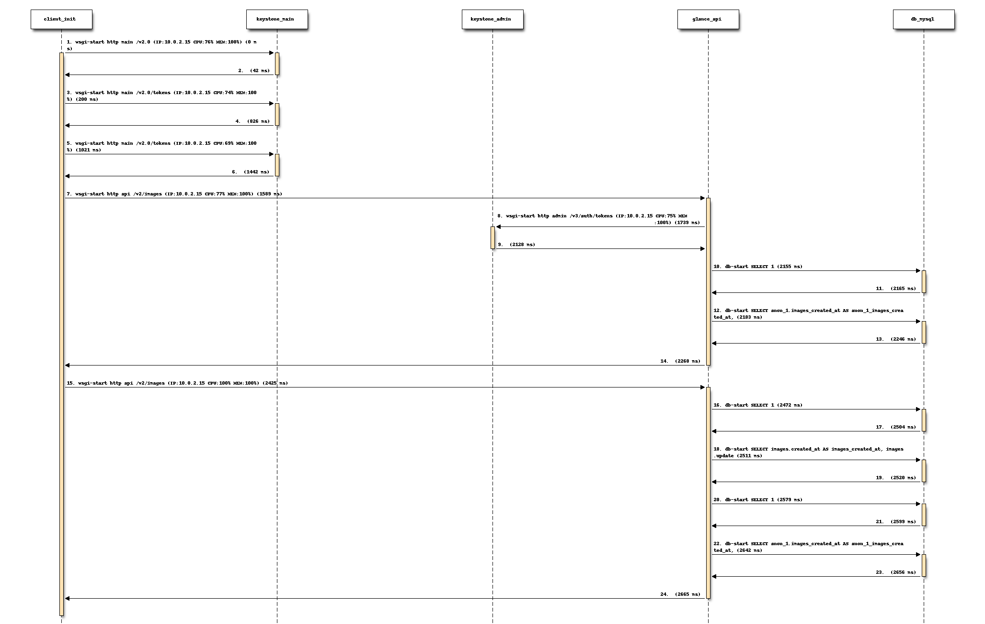
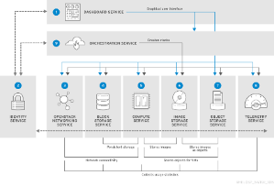
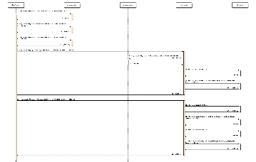
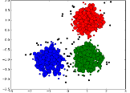
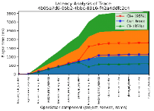
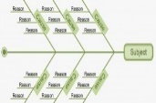
OpenStack Troubleshooting using Distributed Tracing
OpenStack
Openstack Client
REST HTTP
Keystone
main
Keystone
admin
Glance-API
REST HTTP
Database
MySql
A
(18, 17, 17)
B
(23, 18, 17)
B
(25, 18, 17)
A
(18, 17, 17)
C
(14, 17, 17)
{u'base_id': u'58d1ba56-4f6c-4a1d-8dd1-88f4857307ea',
u'children': [],
u'elapsed_time': 929,
u'info': {u'host': u'allinone2.butterfly.org',
u'project': None,
u'request': {u'cpu': u'69',
u'ip': u'10.0.2.15',
u'mem_total': u'11',
u'mem_used': u'10',
u'method': u'GET',
u'path': u'/v3/auth/tokens',
u'query': u'',
u'scheme': u'http'},
u'service': None},
u'name': u'wsgi-start',
u'parent_id': u'7631b6e6-9f77-4c5b-9f62-979fe7dc946a',
u'project': u'keystone',
u'service': u'admin',
u'timestamp': u'2017-03-31T06:21:14.351330',
u'trace_id': u'40bc26d6-da6f-4f5f-93ba-2d959867c7b1'}
Tracing Infrastructure
Distributed Tracing
Distributed context propagation is still new to many people
Applications
Distributed transaction monitoring
Anomaly detection
Performance analysis
Latency optimization
Dependency analysis
Who are my upstream and downstream dependencies?
How many different workflows depend on my service?
Is my service a critical (tier 1) service for core business flows?
How do my SLIs affect other services?
Will my service survive Halloween?
Root cause analysis
Process
Trace user requests
Record traces
Visualize traces
Analyze traces
1.
2.
service_tracing(ctx)
process_tracing(ctx)
progress_task_tracing
horizontal_process
end_tracing(ctx)
hold_tracing(ctx)
start_tracing(ctx)
{
"info": {
"host": "request": {
"ip": "10.0.2.15",
"mem_used": "8",
"mem_total": "11",
"query": "",
"path": "/v2.
0",
"scheme": "http",
3.
4.
Performance analysis, Root-cause analysis, anomaly detection
Trace Requests
Record Traces
Visualize Traces

Slide 6
Troubleshooting using Distributed Tracing Feature Selection
Trace content
Context
Response time
Parent-child relationship
Timestamp
Host, IP, port
Application payload
MEM, CPU, SQL query
Span feature selection
Which features to select? Irrelevant features adversely impact model performance
Use domain knowledge from the field of distributed systems to build a set of ad hoc features
Filter based (univariate selection)
Statistical tests find with a strongest relationship with the output variable
Nominal variables, e.g., chi-squared (chi²) and mutual information
Ordinal variables, e.g., Kendall’s Tau
Numerical, e.g., Pearson Correlation
Wrapper-based
Selection is viewed as a search problem
Embedded
Use algorithms with built-in feature selection methods
e.g., Random Forests
Trace
time
Service A
Service B
Service C
Service D
Service C
{u'base_id': u'58d1ba56-4f6c-4a1d-8dd1….',
u'children': [],
u'elapsed_time': 929,
u'info': {u'host': u'allinone2.butterfly.org',
u'project': None,
u'request': {u'cpu': u'69',
u'ip': u'10.0.2.15',
u'mem_total': u'11',
u'mem_used': u'10',
u'method': u'GET',
u'path': u'/v3/auth/tokens',
u'scheme': u'http'},
u'service': None},
u'name': u'wsgi-start',
u'parent_id': u'7631b6e6-9f77-4c5b-9f6…,
u'project': u'keystone',
u'service': u'admin',
u'timestamp': u'2017-03-31T06:21:14….',
u'trace_id': u'40bc26d6-da6f-4f5f-93ba-2...'}
Raw data
Features
Algorithm
Figure. (above) Trace structure. (bellow) Content of a span. The field info contains the application payload.

Slide 7
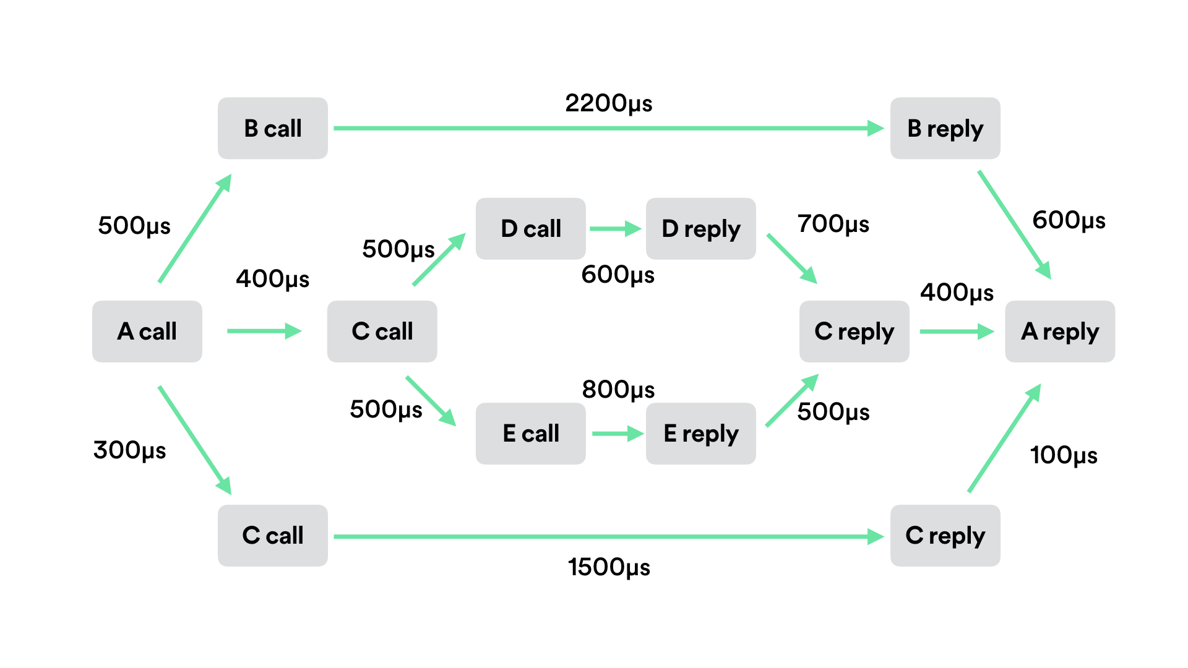
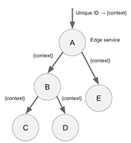
Distributed Traces Trace Abstraction
Markov Chain
A stochastic process is a Markov chain if:
The probability distribution of a state X_{i} depends on the previous state X_{i-1} and does not depend on the previous states
K-th order Markov Chain:
Tree Structure
Finite set of one or more nodes A, B, C, …
Special nodes: the root node has no parent. Leaf nodes have children.
Remaining nodes are partitioned into n >= 0 disjoint sets T1, ..., Tn, where each set is also a tree
Sequence of Events
Given a set E = {e1,...,en} of event types, an event is a pair (A, t), where A ∈ E and t ∈ N is the occurrence time of the event
An event sequence s on E is an ordered sequence of events:
Tree representation: (A (B (C, D), E)
Markov
Chain
Tree
Sequence

Slide 8
Distributed Traces Trace Abstraction
Graph Structure
Graph is a set of vertices V, with edges connecting some of the vertices (edge set E).
An edge can connect two vertices.
Use maximum common sub-graph isomorphism (MCS) and the graph edit distance (GED) to compare graphs
e.g., GED defines the minimal number of operations (node/edge substitution, insertion, removal) needed to transform one graph into another
MCS and GED problems are NP-hard
Service A
Graph
Service B
Service C
Service C
Service D

Slide 9
Troubleshooting using Distributed Tracing Techniques and Methods
Distributed Trace Analysis
Time series analysis
Spans and traces seen as time series of response time
Statistical methods
Parametric and non-parametric
Sequence analysis
Traces seen as sequences of spans
Methods: Clustering, classification, knowledge-based
Neural networks, Bayesian, SVM, decision trees, DBSCAN, K-mean, k-NN
Graph analysis
Traces seen as graphs or trees
Methods: Markov chains, graph distance metrics, sub-graph isomorphism

Slide 10
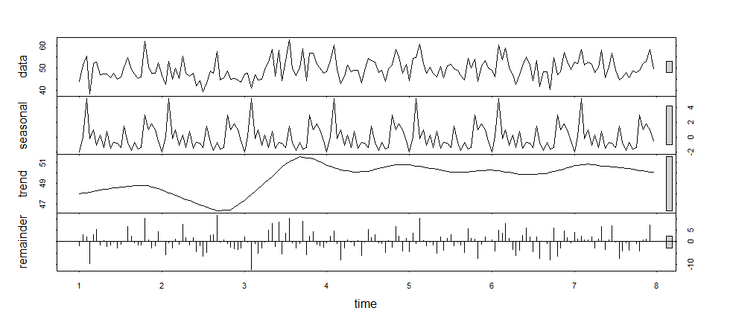
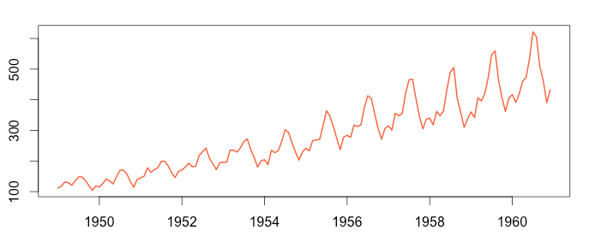
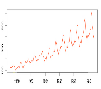
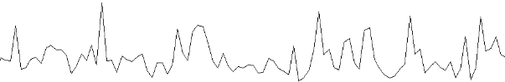
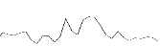
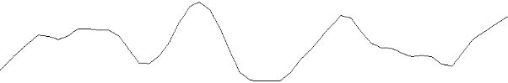
Distributed Trace Analysis Time Series Analysis
Time Series
Sequence of observations, measured at successive equally spaced time intervals collected from a process
Time series analysis
Targets to understand the context of observations or to make predictions.
Time series forecasting
Relies on models to forecast future observations based on previous ones.
Anomaly detection using exponential smoothing
Exponential smoothing weighs recent observations more than older ones
α is the smoothing constant
S_{t} is the smoothed value of observations
Forecast F_{t+1} = S_{t}
Distributed Trace
-- Normal or abnormal?
Distributed Trace
Forecasted
Trace in 12 hours
spans
Trace ID: 189X34
spans
|
|--> Normal or abnormal?
C
(14, 17, 17)
d4
Time Series
C
(14, 17, 17)
d4
D4
d4
D4
d4
Normal
time
t1
t2
time
A
(18, 17, 17)
A
(18, 17, 17)
D3
d3
d3
Abnormal
d3
D3
d3
time
B
(23, 18, 17)
time
time
B
(23, 18, 17)
time
d2
d2
D2
d2
D2
d2
Normal
B
(23, 18, 17)
time
B
(23, 18, 17)
time
D1
d1
d1 = Δ(ts(B), ts(A))
d1
d1 = Δ(ts(B), ts(A))
d1
D1
d1
Normal
A
(18, 17, 17)
time
A
(18, 17, 17)
time
spans
spans
Forecasted behavior
Representation: Discrete Fourier transformation, singular value decomposition, piecewise aggregate approximation, symbolic aggregate approximation, spline representation, etc.

Slide 11
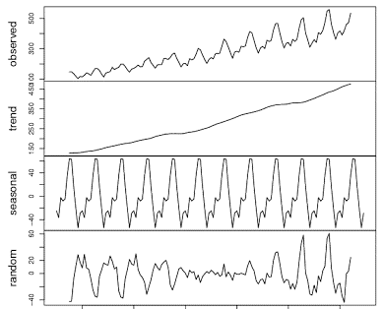
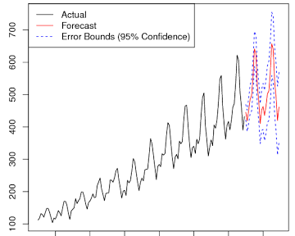
Distributed Trace Analysis Forecasting Failures
Distributed Trace
A
(18, 17, 17)
B
(23, 18, 17)
B
(23, 18, 17)
A
(18, 17, 17)
C
(14, 17, 17)
D
(26, 14, 17)
E
(34, 26, 17)
E
(34, 26, 17)
D
(26, 14, 17)
C
(18, 17, 17)
time
@Compute node #254 = elapsed_time( D, D )
Compute node needs to be removed from cloud
Compute node will saturate in 2 days
@Compute node #254 = MEM, CPU while processing( D, D )
Trend
Seasonal
https://www.otexts.org/fpp
Time Series forecasting
Linear regression
Moving average
Time series decomposition
ARIMA
Dynamic Regression Models
Vector Autoregression
Exponential Smoothing
Detect temporal drifts based on data from trace event streams. React to drifts as soon as possible to lessen impact of platform errors to SLA
1 2 3 4 5 6 7 8 9 10 11 12 13 14 15 16 17 18 19 20
1 2 3 4 5 6 7 8 9 10 11 12 13 14 15 16 17 18 19 20
decomposition = sm.tsa.seasonal_decompose(y, model='additive')
fig = decomposition.plot() plt.show()
fit <- arima(ComputeProcessing, order=c(1,0,0), …)
fore <- predict(fit, n.ahead=24)

Slide 12
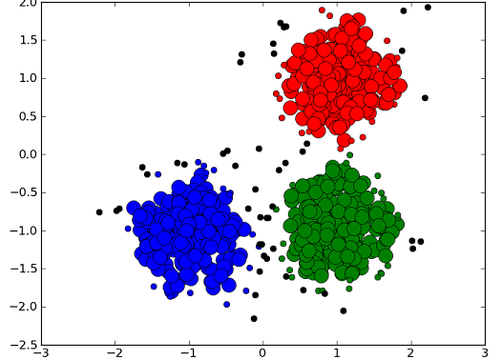
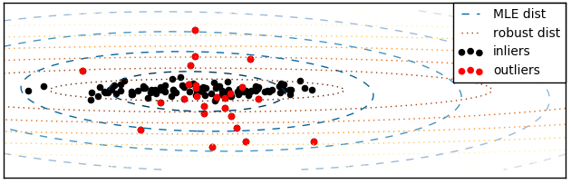
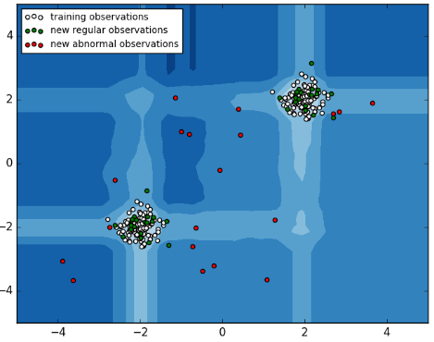
Distributed Trace Analysis Sequence Analysis
Distributed Trace
Span
Span
A
(18, 17, 17)
B
(23, 18, 17)
B
(23, 18, 17)
A
(18, 17, 17)
C
(14, 17, 17)
D
(26, 14, 17)
E
(34, 26, 17)
E
(34, 26, 17)
D
(26, 14, 17)
C
(18, 17, 17)
time
Clustering
A, B, B, A, C, D, E, E, D, C
A, B, G, G, B, A, C, D, E, E, D, C
A, B, B, A, C, D, E, E, D, C, F, F
Outlier Detection
Unsupervised learning from traces:
estimator.fit(X_train)
covariance.EllipticEnvelope
new traces can then be sorted as outliers:
estimator.predict(X_test)
Inliers are labeled 1, while outliers are labeled -1.
Outliers
More accurate
performance estimation
Extreme Value Analysis
Assume a distribution (Gaussian) for duration of traces
Look for values more than 2 or 3 standard deviations from the mean or 1.5 times from the first or third quartile
Filter out outliers candidates
Outlier Detection
ensemble.IsolationForest ‘isolates’ traces by randomly selecting a feature
Then randomly selects a split value between the maximum and minimum values
Proximity Methods
Use clustering to identify the natural clusters of similar traces
Identify and mark the cluster centroids
Identify traces that are a fixed distance or percentage distance from cluster centroids
Filter out outliers candidates
Distance Measure
Eucledian distance
Dynamic time warping
Longest common subsequence
Etc.

Slide 13

Distributed Trace Analysis Sequence Analysis
Distributed Trace
Trace ID: 189X34
event
C
(14, 17, 17)
Trace change analysis
Trace invariants. A program invariant is a predicate that always holds the same value under different workloads or inputs.
By checking whether a trace sequence violates the invariants, we can detect system problems.
A timeout anomaly occurs when an expected event in a trace is not seen within an expected time interval.
d4
A
(18, 17, 17)
server S4,2
d3
Trace ID: 23T874
time
B
(23, 18, 17)
d2
B
(23, 18, 17)
d1
trace (top level span)
Missing event from trace: error in customer facing service
A
(18, 17, 17)
transition
Missing event from transition: error in communication
event
A
(18, 17, 17)
B
(25, 18, 17)
B
(25, 18, 17)
A
(18, 17, 17)
C
(14, 17, 17)
D
(26, 14, 17)
E
(34, 26, 17)
E
(34, 26, 17)
D
(26, 14, 17)
C
(14, 17, 17)
Operation (span)
Missing event from span: service failure

Slide 14

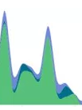



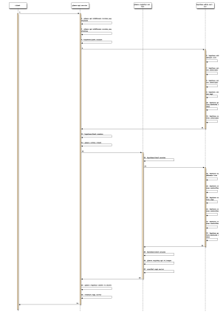
Distributed Trace Analysis Sequence Analysis
1. User commands: image delete, create server, image list, flavor set…
2. A distributed trace is generated
3. The distributed trace is encoded into a sequence
Warning A
keystone -> nova -> glance -> network
70%
30%
Warning B
N2
N1
Warning C
Warning Y
N3
Error Z
image-api
compute
network
scheduler
Sequence of spans
rpc-broker
compute-api
Trace t1
image-registry
authentication
a1
62
e2
28
Services
N4
Trace of Openstack create server: scheduler, authentication, image-api, rpc-broker, image-registry, compute-api, compute, …. [a1, 62, e2, …., 28]
{"traceId": "72c53", "name": "get", "timestamp": 1529029301238, "id": "df332", "duration": 124957, “annotations": [{"key": "http.status_code", "value": "200"}, {"key": "http.url", "value": "https://v2/e5/servers/detail?limit=200"}, {"key": "protocol", "value": "HTTP"}, "endpoint": {"serviceName": "hss", "ipv4": "126.75.191.253"}]
4. Sequence Classification: identify invalid sequences
Function call sequences
Similar call sequence
Encoding matching
53.47%
auth_tokens_v3 1314421019193f1313162f253233191e341a3c3b402f2624192f214521162f163e2746282c192f2e2e24161d2c2c161628241635287a
images_v2 4342421119131616161a311316192216162f23213e1d2127272728241621191d5e5c471d132c4a16241616213c63
_var__detail_flavors_v2.1 5d13421314151316161b193b21242113364024192f162f131d21161621212c27282c2c2d162f5e5c132c16164d
image_schemas_v2 141319133113162f1644161b331e351a213b1613133b13192f5116132113131616252121282c2c162d21582e2e161d13643b132c4a78134d213c21
gather_result 1912141613252128211a1f402f221921162f2713282b2d2416131d13211a5a21
security-groups_v2.0 4c1319131d19131316132f
_var__images_v2 121313251b2f192f35211f241916223b1613231616242713462c53241654192c285a21
_var___var__action_servers_v2.1 61135d106c12131325191b1c193d281a4022136d13162f3b292116231d1627272741283b2416131d5c2f4a5121352f13
neutronclient.v2_0.client.retry_request 162f1319132f165124191316
Service call encoding
13: {'v3', 'tokens', 'auth‘}
Function call sequences
[{'v3'}=200, {'v3', 'tokens', 'auth'}=200, {'v...
Service call encoding
16: {'v2.0', 'ports'}
51 : {'v2.0', '_var_', 'ports'}=200
24 : {'nova.compute.api.API.get'}=0
…
Tracing has applicability in many fields besides microservices, e.g., end-to-end enterprise applications orchestrating mobile apps, edges, websites, storage, and centralized systems.

Slide 15
Distributed Trace Analysis Introduction to Sequence Analysis
Sequence Prediction
Predict elements of a sequence on the basis of the preceding elements
Given si, si+1,…, sj, predict sj+1, si,si+1, i.e., sj →sj+1
Input: 1, 2, 3, 4, 5; output: 6
Applications: weather forecast
Sequence Classification
Predict a class label for a given input sequence.
Given si,si+1,…,sj, determine if it is legitimate, i.e., si,si+1,…,sj →yes or no
Input: 1, 2, 3, 4, 5; output: “normal” or “anomalous”
Applications: trace anomaly detection, DNA sequence classification
Sequence Generation
Generate new output sequence with same general characteristics as the input
Input: [1, 3, 5], [7, 9, 11]; output: [3, 5 ,7]
Applications: text generation
Sequence to Sequence Prediction
Predict an output sequence given an input sequence.
Input: 1, 2, 3, 4, 5; output: 6, 7, 8, 9, 10
Applications: text summarization
1, 2, 3, 4, 5 ► 6
1, 2, 3, 4, 5 ► NORMAL
1, 3, 5 and 7, 9, 11 ► 3, 5 ,7
1, 2, 3, 4, 5 ► 6, 7, 8, 9, 10
Sequence learning: from recognition and prediction to sequential decision making, IEEE Intelligent Systems, 2001, http://www.sts.rpi.edu/~rsun/sun.expert01.pdf

Slide 16
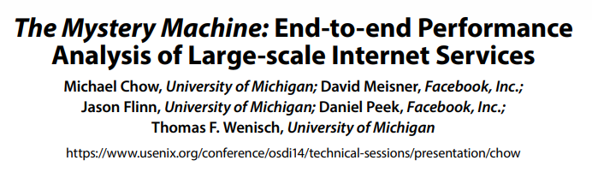

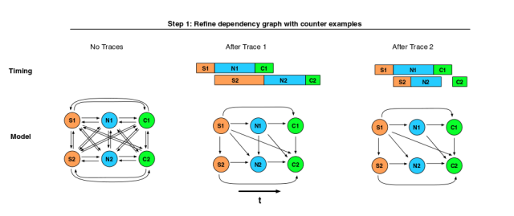
Related Work Facebook Mystery Machine
Measure end-to-end performance of requests
Infer causal relationships from logs
Adding instrumentation retroactively is an expensive task
Hypothesize and confirm relationships in messages
Log Data
Request & host id, timestamp, unique event label
Finding Relationships
Samples requests, store logs in Hive and run Hadoop jobs to infer causal relationships
2h Hadoop to analyze 1.3M requests sampled 30 days
Assumes a hypothesized relationship between two segments until finding a counterexample
3 types of relationship inferred: happens-before, mutual exclusion, pipeline
Applications
Find critical path and slack segments for performance optimization
Anomaly detection: 1) select top 5% of end-to-end latency, 2) identify segments with proportionally greater representation in the outlier set of requests than in the non-outlier set.
As the number of traces analyzed increases, the observation of new counter examples diminishes, leaving behind only true relationships
https://blog.acolyer.org/2015/10/07/the-mystery-machine-end-to-end-performance-analysis-of-large-scale-internet-services/
https://www.usenix.org/system/files/conference/osdi14/osdi14-paper-chow.pdf

Slide 17
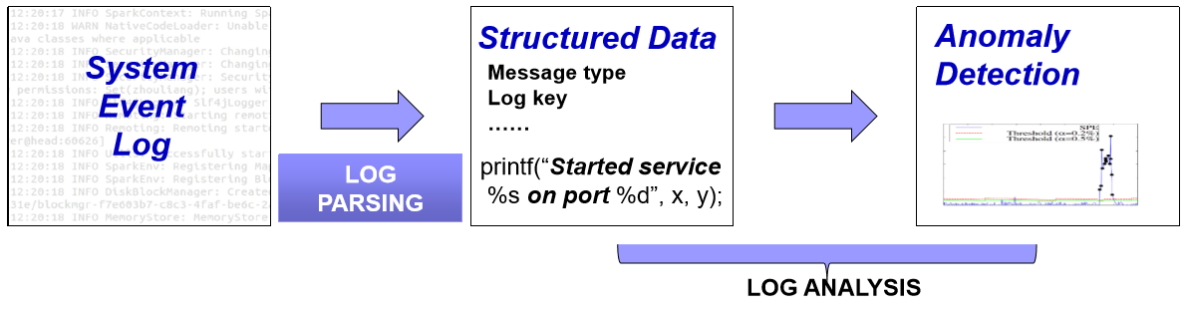
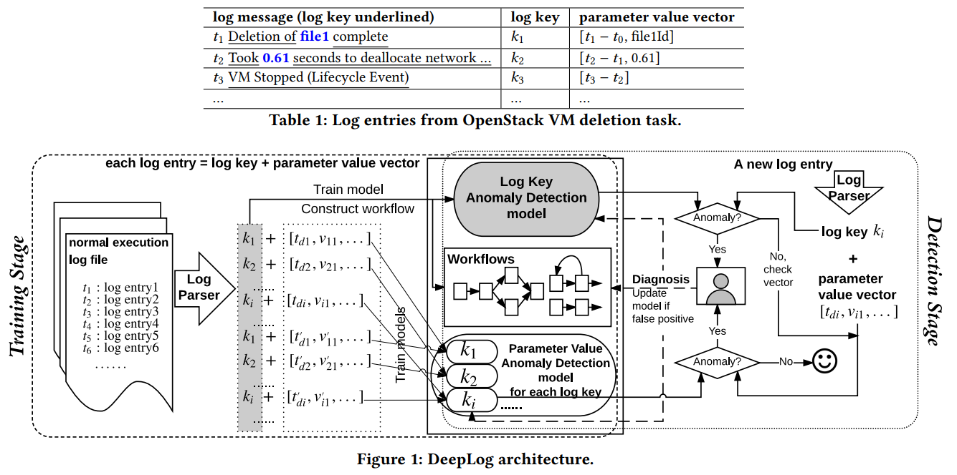
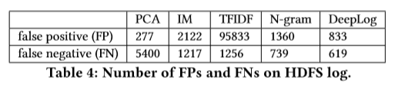
Related Work Sequence Analysis of Log Records
Sequence Prediction using Logs
Parsing
Spell tool (ICDM’16) parses logs into patterns that represent the fixed part of printf-like statements
Log messages ► Log key
https://www.cs.utah.edu/~lifeifei/papers/spell.pdf
Processing
Workflow models are built to help anomaly diagnosis
Log Key ► Workflow
Log Key + Parameters ► Behavior Model
LSTM is used to model system execution paths and log parameter values
Precision
F1-score: 96%
How many scenarios need to be labeled? 10 or 10,000?
Dataset distribution
HDFS: 2.9% labeled anomalies
Openstack: 7% anomalies
Do precision numbers hold in more realistically distributed logs?
Min Du, Feifei Li, Guineng Zheng, and Vivek Srikumar. 2017. DeepLog: Anomaly Detection and Diagnosis from System Logs through Deep Learning. In Proceedings of the 2017 ACM SIGSAC Conference on Computer and Communications Security (CCS '17). ACM, New York, NY, USA, 1285-1298.

Slide 18


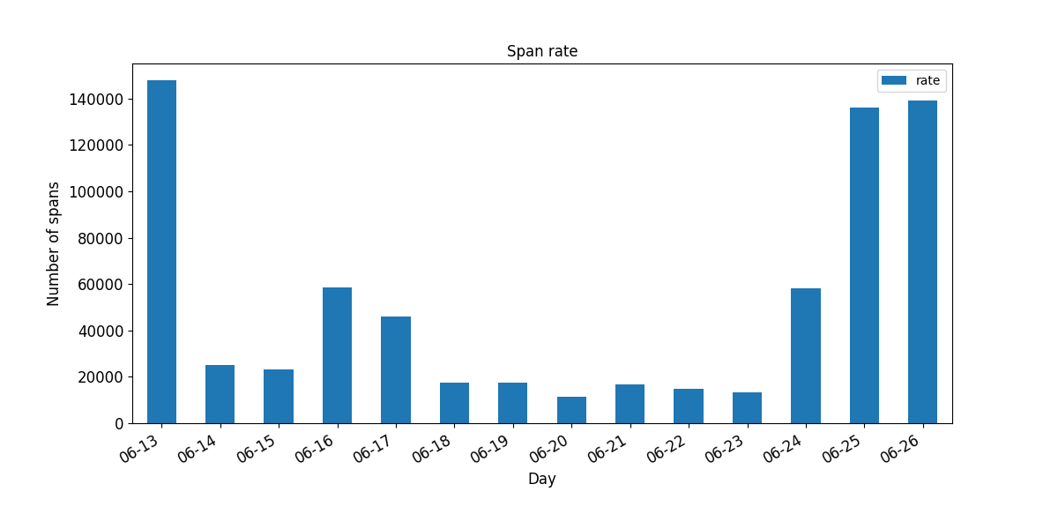
Distributed Trace Analysis Trace and Span Representation
Training
Collect traces
Parse and abstract spans
Feed span lists to deep neural network
Train the network with traces
Testing
Collect real-time traces
Parse and abstract spans
Feed span lists to deep neural network
Retrieve probability matrix
Analyze matrix to decide on the severity of the anomaly
In this experiment, we processed >1M spans and >100K traces
Partial view of the spans collected
auth_tokens_v3 1314421019193f1313162f253233191e341a3c3b402f2624192f214521162f163e2746282c192f2e2e24161d2c2c161628241635287a
images_v2 4342421119131616161a311316192216162f23213e1d2127272728241621191d5e5c471d132c4a16241616213c63
_var__detail_flavors_v2.1 5d13421314151316161b193b21242113364024192f162f131d21161621212c27282c2c2d162f5e5c132c16164d
image_schemas_v2 141319133113162f1644161b331e351a213b1613133b13192f5116132113131616252121282c2c162d21582e2e161d13643b132c4a78134d213c21
gather_result 1912141613252128211a1f402f221921162f2713282b2d2416131d13211a5a21
security-groups_v2.0 4c1319131d19131316132f
_var__images_v2 121313251b2f192f35211f241916223b1613231616242713462c53241654192c285a21
_var___var__action_servers_v2.1 61135d106c12131325191b1c193d281a4022136d13162f3b292116231d1627272741283b2416131d5c2f4a5121352f13
neutronclient.v2_0.client.retry_request 162f1319132f165124191316
auth_tokens_v3 13__421019193f1313162f253233191e341a3c3b402f2____4192f214521162f163e2746282c192f2e2f44161d2c2c161628241635287a
Is this trace recognized by the model? Are these change significative? Are they associated with an system anomaly?
We analyze historical traces and collect the spans generated to create a structure containing span types (symbols) using label encoding (e.g., 12, 23).
The network is training with the encoded traces. During operation, an LSTM network takes as input a sequence of symbols representing a new real-time trace, e.g., 1: “72”, 2: “83”, 3: “54”, …n: “23”.
The output is a matrix with the probability of each symbol to belong to a learned structure.
The analysis of the probability matrix enables to reason on if a trace should be mark are normal or anomalous.

Slide 19
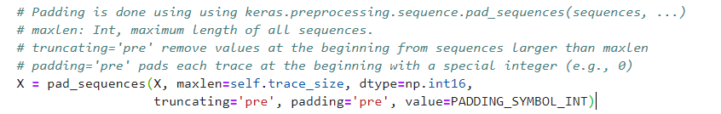

Distributed Trace Analysis Using LSTMs
1. Generate Synthetics Traces
OPENSTACK_SEQUENCE = [
('keystone', 1.0, 'authenticate user with credentials and generate auth-token'),
('nova-api', 1.0, 'get user request and sends token to Keystone for validation'),
('keystone', 0.2, 'validate the token if not in cache'),
('nova-api', 1.0, 'starts VM creation process'),
('nova-database', 1.0, 'create initial database entry for new VM'),
('nova-scheduler', 1.0, 'locate an appropriate host using filters and weights'),
('nova-database', 1.0, 'execute query'),
('nova-compute', 1.0, 'dispatches request'),
('nova-conductor', 1.0, 'gets instance information'),
('nova-compute', 1.0, 'get image URI from image service'),
('glance-api', 1.0, 'get image metadata'),
('nova-compute', 1.0, 'setup network'),
('neutron-server', .5, 'allocate and configure network IP address'),
('nova-compute', 1.0, 'setup volume'),
('cinder-api', .75, 'attach volume to the instance or VM'),
('nova-compute', 1.0, 'generates data for the hypervisor driver')
]
1
3
2. Transform traces with service names into sequences of integers
Train dataset
span_list
trace_id
0 [3, 5, 5, 8, 9, 8, 6, 7, 6, 2, 6, 6, 1, 6]
1 [3, 5, 5, 8, 9, 8, 6, 7, 6, 2, 6, 6, 1, 6]
2 [3, 5, 5, 8, 9, 8, 6, 7, 6, 2, 6, 4, 6, 1, 6]
3 [3, 5, 5, 8, 9, 8, 6, 7, 6, 2, 6, 4, 6, 6]
4 [3, 5, 3, 5, 8, 9, 8, 6, 7, 6, 2, 6, 6, 1, 6]
... ...
95 [3, 5, 5, 8, 9, 8, 6, 7, 6, 2, 6, 6, 1, 6]
96 [3, 5, 3, 5, 8, 9, 8, 6, 7, 6, 2, 6, 4, 6, 6]
97 [3, 5, 5, 8, 9, 8, 6, 7, 6, 2, 6, 6, 1, 6]
98 [3, 5, 5, 8, 9, 8, 6, 7, 6, 2, 6, 4, 6, 1, 6]
[3, 5, 5, 8, 9, 8, 6, 7, 6, 2, 6, 4, 6, 1, 6]
[100 rows x 1 columns]
Test dataset
span_list
trace_id
0 [3, 5, 5, 1, 9, 8, 6, 7, 6, 2, 6, 6, 1, 6]
1 [3, 5, 5, 8, 9, 8, 6, 7, 6, 2, 6, 4, 6, 6]
[0,
['keystone',
'nova-api',
'nova-api',
'nova-database',
'nova-scheduler',
'nova-database',
'nova-compute',
'nova-conductor',
'nova-compute',
'glance-api',
'nova-compute',
'nova-compute',
'cinder-api',
'nova-compute']]
Cache Simulation: Probability of execution = 75%
Trace #0
4. Encoding traces sequences
The encoding scheme pads each sequence of inputs with zeros, up to a pre-defined maximum length.
This allows to pre-allocate a chain of LSTM units of a specific length
We also pass information about the sequence lengths. This is important for not treating the zero padding as actual inputs, and from injecting the error signal at the right unit in the sequence during back propagation.
Hot encoding
A one hot encoding enables to represent categorical variables as binary vectors.
Categorical values are mapped to integer values.
Each integer value is represented as a binary vector that is all zero values except the index of the integer, which is marked with a 1.
4
2
Padding with symbol 0
[[0 0 3 ... 6 1 6]
[0 0 3 ... 6 1 6]
[0 3 5 ... 6 1 6]
...
[0 0 3 ... 6 1 6]
[0 3 5 ... 6 1 6]
[0 3 5 ... 6 1 6]]
Hot encoding not shown
Tensorflow tutorial: https://github.com/campdav/text-rnn-tensorflow
Keras tutorial: https://github.com/campdav/text-rnn-keras
Code available at: https://github.com/jorge-cardoso/aiops_practice
Subdirectory: dta_lstm

Slide 20
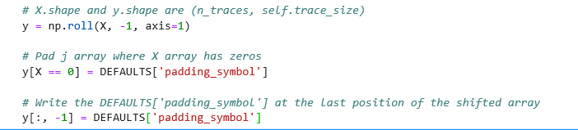
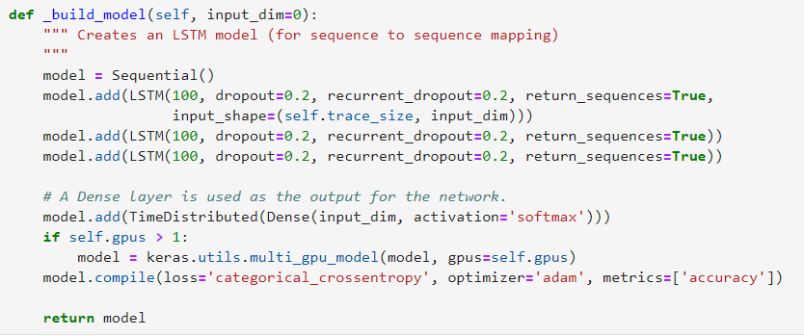
Distributed Trace Analysis Using LSTMs
5
Shift traces left
X [[0 0 3 ... 6 1 6]
[0 0 3 ... 6 1 6]
[0 3 5 ... 6 1 6]
...
[0 0 3 ... 6 1 6]
[0 3 5 ... 6 1 6]
[0 3 5 ... 6 1 6]]
y [[0 0 5 ... 1 6 0]
[0 0 5 ... 1 6 0]
[0 5 5 ... 1 6 0]
...
[0 0 5 ... 1 6 0]
[0 5 5 ... 1 6 0]
[0 5 5 ... 1 6 0]]
6
Create the DL model
Keras and Tensorflow
LSTM network
dropout layer of 0.2 (high, but necessary to avoid quick divergence)
Softmax activation to generate probabilities over the different categories
Because it is a classification problem, loss calculation via categorical cross-entropy compares the output probabilities against one-one encoding
ADAM optimizer (instead of the classical stochastic gradient descent) to update weights

Slide 21
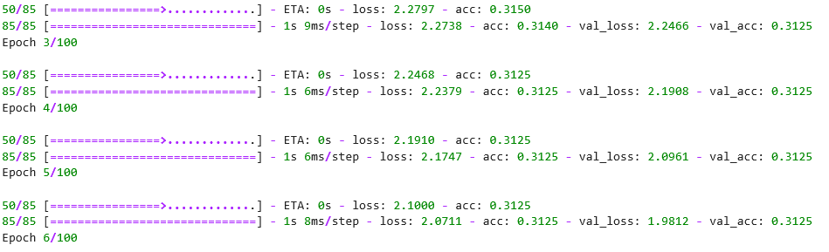
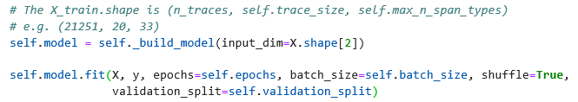
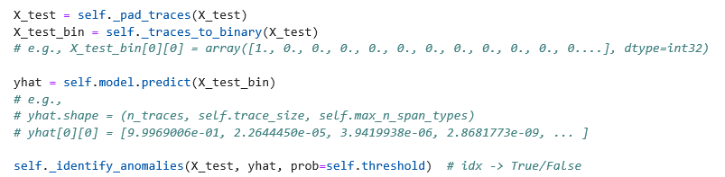
Distributed Trace Analysis Using LSTMs
7
Train the model
8
Test traces
Test Traces
X [[0 0 3 5 5 1 9 8 6 7 6 2 6 6 1 6]
[0 0 3 5 5 8 9 8 6 7 6 2 6 4 6 6]]
X[0]: [0 0 3 5 5 1 9 8 6 7 6 2 6 6 1 6] =
[[0, 0.2625601], [1, 0.38167596], [0, 0.75843567],
[0, 0.8912414], [9, 2.394792e-05], [0, 0.94694203],
[0, 0.9656691], [0, 0.9686248], [0, 0.9666971],
[0, 0.95213455], [0, 0.94981205], [0, 0.93016535],
[0, 0.60129535], [0, 0.5417027], [0, 0.6876041],
[0, 0.82936114]]
X[1]: [0 0 3 5 5 8 9 8 6 7 6 2 6 4 6 6] =
[[0, 0.2625601], [1, 0.38167596], [0, 0.75843567],
[0, 0.8912414], [0, 0.9302344], [0, 0.94507533],
[0, 0.9638574], [0, 0.9665326], [0, 0.9627945],
[0, 0.9435249], [0, 0.9405963], [0, 0.92075515],
[1, 0.3207201], [1, 0.46595544], [0, 0.64980185],
[0, 0.8390282]]
trace_id 0 indices [4]
trace_id 1 indices []

Slide 22
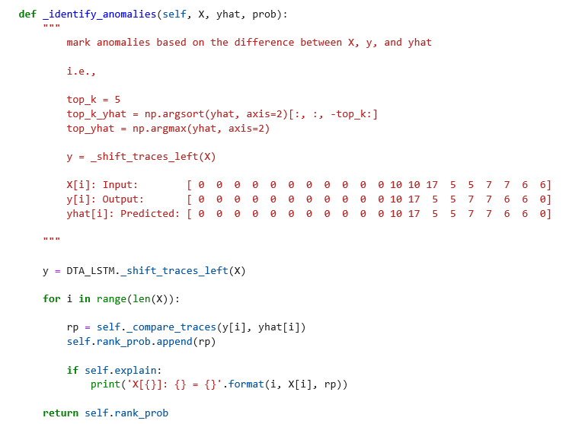
Distributed Trace Analysis Using LSTMs
9
Identifying Anomalous Traces Sequences
Test Trace
Input X = [0 0 3 5 5 1 9 8 6 7 6 2 6 6 1 6]
Shifted_X = [0 0 5 5 1 9 8 6 7 6 2 6 6 1 6 0]
Prediction
yhat = [0 0 5 5 12 9 8 6 7 6 2 6 6 1 6 0]
X[0]: [0 0 3 5 5 1 9 8 6 7 6 2 6 6 1 6] =
[[0, 0.2625601], [1, 0.38167596], [0, 0.75843567],
[0, 0.8912414], [9, 2.394792e-05], [0, 0.94694203],
[0, 0.9656691], [0, 0.9686248], [0, 0.9666971],
[0, 0.95213455], [0, 0.94981205], [0, 0.93016535],
[0, 0.60129535], [0, 0.5417027], [0, 0.6876041],
[0, 0.82936114]]
Error at index [4]

Slide 23
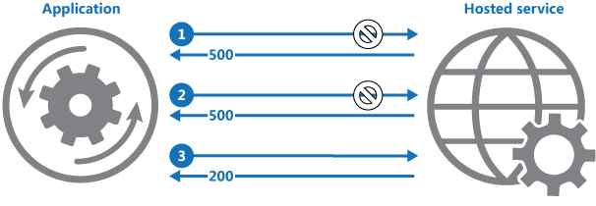
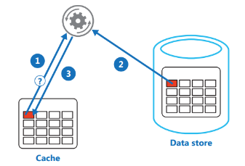
Distributed Trace Analysis Why is trace analysis challenging?
Many “Hidden” Software “Patterns” which affect running systems…Circuit breaker, concurrency and parallelism, priority queues, publisher-subscriber, bulkhead, etc.
1. Retry pattern
n_tries = 3
while True:
try:
ExecuteOperation() # Success
break
except TimeoutException:
if n_tries == 0: # give up
raise Failure
else:
sleep(1000) # Wait until retrying the call
T1: A, B, C, D, E, …
T2: A, B, C, C, D, E, ….
T3: A, B, C, C, C, D, E, …
T4: A, B, C, C, C, Z
2. Cache-Aside pattern
v = cache.get(k)
if v == None: # Check if the item is in the cache
v = store.get(k) # If not in cache, read from data store
cache.put(k, v) # Put a copy of the item into the cache
T1: A, B, C, D, E, …
T1: A, C, D, E, …
3. One-to-many subcalls
@app.route('/servers/<int:user_id>/<int:number>')
def create(user_id, number):
for i in range(number):
authentication(user_id)
# Call remote microservice to create a server
rpc.create_server()
T1: A, B, C, D, E, …
T2: A, B, C, C, D, E, ….
T3: A, B, C, C, C, D, E, …
T4: A, B, C, C, C, C, D, E, …

Slide 24
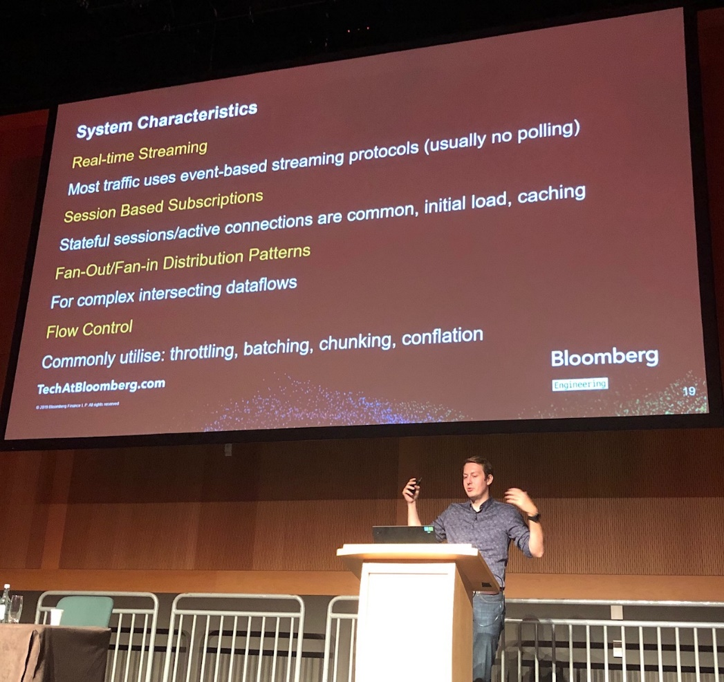
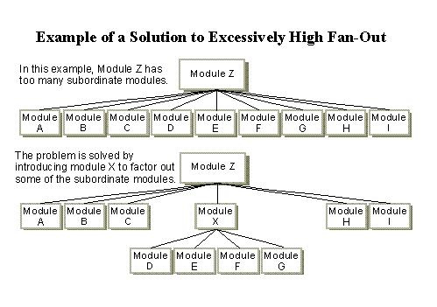
Distributed Trace Analysis Why is trace analysis challenging?
More design patterns
Design Principles: Fan-In vs Fan-Out
Lazy loading (also called on-demand loading) is an optimization technique for the online content, be it a website or a web app
Chunking is a specific feature of the HTTP 1.1 protocol. Here, the meaning is the opposite of that used in memory management. It refers to a facility that allows inconveniently large messages to be broken into conveniently-sized smaller "chunks"

Slide 25
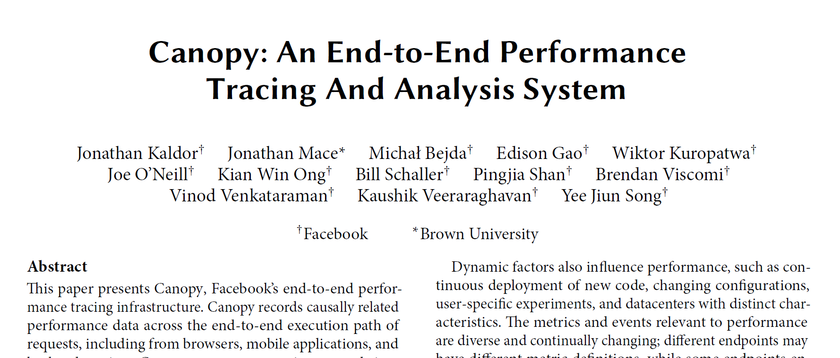
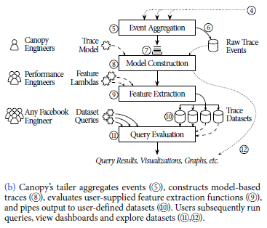
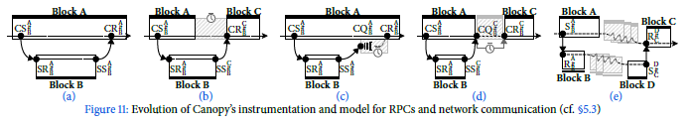
Distributed Trace Analysis Why is trace analysis challenging?
Inspired by Facebook Canopy design (http://cs.brown.edu/~jcmace/papers/kaldor2017canopy.pdf)
Span Model
Introduced in Google Dapper in 2010, base model in Zipkin
Suitable to describe synchronous REST operations
Every span consists of 4 events: “client send”, “server receive”, “server send”, “client receive”
Limitations of span model
Non-synchronous execution models such as queues and asynchronous executions can not be described as span trees
Fine-grained metrics are hard to express, e.g. RPC response handler can read the data from network then enqueue it and then process – queue time is not taken into account
Multithreaded processing, like spawning of a group of threads, then joining them requires additional tags to differ from sequential processing.
Evolution of trace model in Facebook*
Started with Dapper span model
Idle (blocked) time is taken into account
Internal queue is taken into account
Client-queue metrics for AJAX processing are added
Request and response are completely decoupled, trace is represented as set of events with causal relations
Facebook uses end-to-end tracing for all services, from data-center to mobile applications. As of 2017 the system processes 1.3 billion traces per day, each trace contains up to several thousands of events.
* http://cs.brown.edu/~jcmace/papers/kaldor2017canopy.pdf

Slide 26
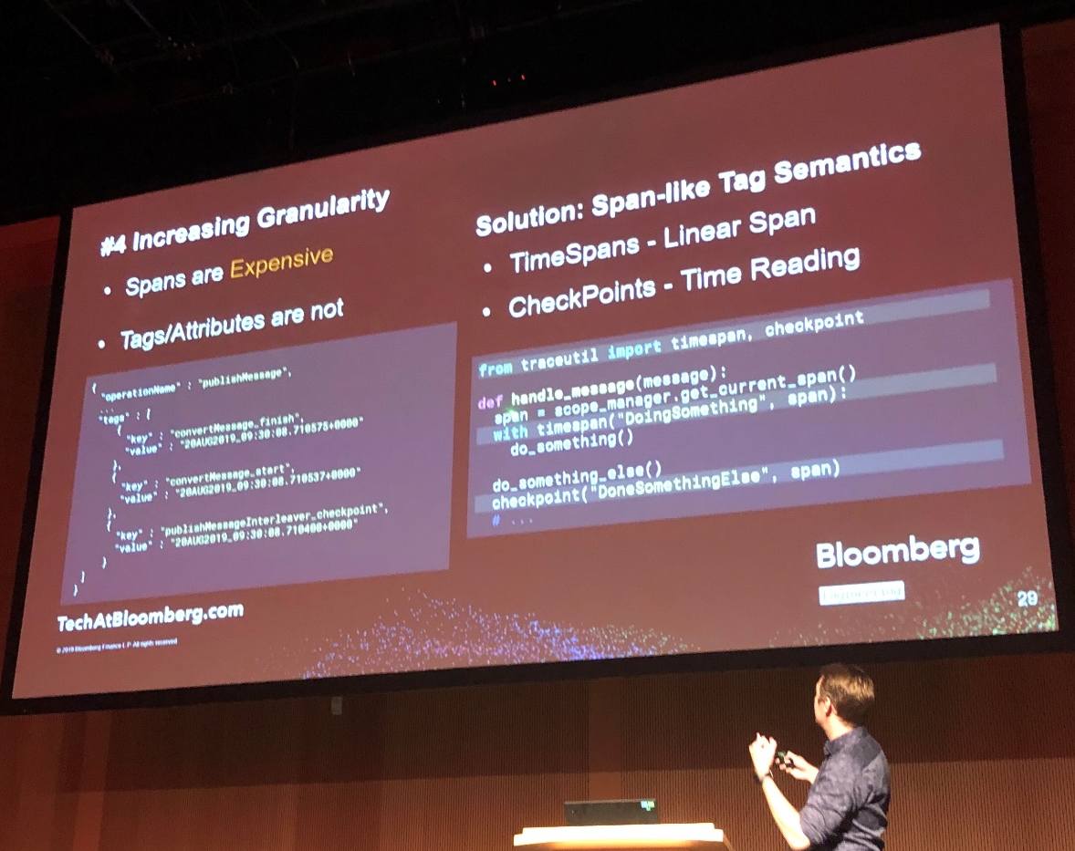
Distributed Trace Analysis Why is trace analysis challenging?
Add Span Semantics
Work at Bloomberg
Semantics: linear span, time reading, etc/
Tracing Real-Time Distributed Systems, Evgeny Yakimov, Bloomberg,
SREcon19 EMEA, 2-4 October, 2019, Dublin, Ireland.

Slide 27

Distributed Trace Analysis Using Multimodal Deep Learning
Monitoring and Incident Detection
Anomaly detection in large-scale system is widely studied
IT monitoring systems typically use application logs and resource metrics to detect failures
Distributed tracing is becoming the third pillar of microservices observability
Logs and metrics were previously investigated (see [1-4])
Single and Bi-Models
Use of single and bi-models to capture traces as sequences of events and their response time
Use sequential model representation by utilizing long-short-term memory (LSTM) networks
Results
Detect anomalies in Huawei Cloud infrastructure
The novel approach outperforms other deep learning methods based on traditional architectures
Idea: represent distributed traces as sequences of events and their response time
Long Short Term Memory (LSTM)
LSTMs [1] are models which capture sequential data by using an internal memory. They are very good for analyzing sequences of values and predicting the next point of a given time series. This makes LSTMs adequate for Machine Learning problems that involve sequential data (see [3]) such speech recognition, machine translation, visual recognition and description, and distributed traces analysis.
[1] Hochreiter, Sepp, and Jürgen Schmidhuber. "Long short-term memory." Neural computation 9.8 (1997): 1735-1780.
[2] Sequential processing in LSTM (from: http://colah.github.io/posts/2015-08-Understanding-LSTMs/
[3] LSTM model description (from Andrej Karpathy. http://karpathy.github.io/2015/05/21/rnn-effectiveness/
S. Nedelkoski, J. Cardoso, O. Kao, Anomaly Detection from System Tracing Data using Multimodal Deep Learning, IEEE Cloud 2019, July 3-8, 2019, Milan, Italy.
S. Nedelkoski, J. Cardoso, O. Kao, Anomaly Detection and Classification using Distributed Tracing and Deep Learning, CCGrid 2019, 14-17.05, Cyprus.
J. Cardoso, Mastering AIOps with Deep Learning, Presentation at SRECon18, 29–31 August 2018, Dusseldorf, Germany.

Slide 28
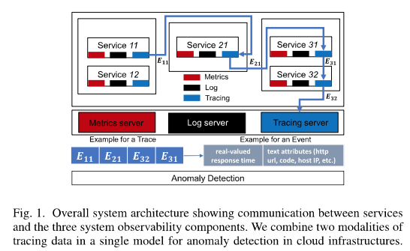
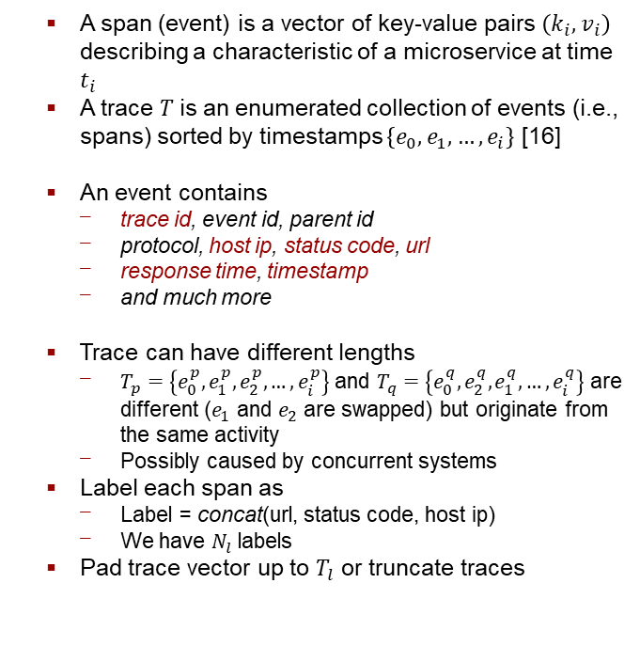
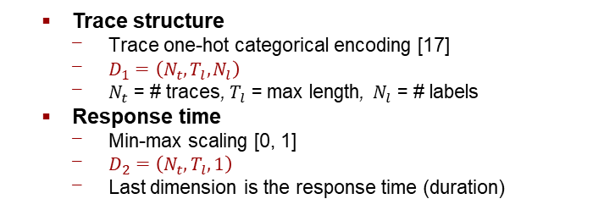
Distributed Trace Analysis Bi-modal Approach
Trace Structure (sequence of events) and
Response time (duration)
e.g., Service 11 → Service 21; duration = 12ms
A span (event) is a vector of key-value pairs $\left(k_{i},v_{i}\right)$ describing a characteristic of a microservice at time $t_{i}$
A trace $T$is an enumerated collection of events (i.e., spans) sorted by timestamps $\left\{e_{0},e_{1}, …,e_{i}\right\}$ [16]
An event contains
trace id, event id, parent id
protocol, host ip, status code, url
response time, timestamp
and much more
Trace can have different lengths
$T_{p}=\left\{e_{0}^{p},e_{1}^{p},e_{2}^{p},…,e_{i}^{p}\right\}$ and $T_{q}=\left\{e_{0}^{q},e_{2}^{q},e_{1}^{q},…,e_{i}^{q}\right\}$ are different ($e_{1}$ and $e_{2}$ are swapped) but originate from the same activity
Possibly caused by concurrent systems
Label each span as
Label = concat(url, status code, host ip)
We have $N_{l}$ labels
Pad trace vector up to $T_{l}$ or truncate traces
Trace structure
Trace one-hot categorical encoding [17]
$D_{1}=\left(N_{t},T_{l},N_{l}\right)$
$N_{t}$ = # traces, $T_{l}$ = max length, $N_{l}$ = # labels
Response time
Min-max scaling [0, 1]
$D_{2}=\left(N_{t},T_{l},1\right)$
Last dimension is the response time (duration)

Slide 29
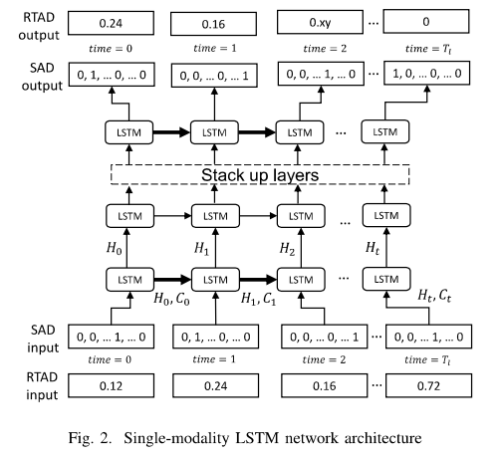


Distributed Trace Analysis Single-Modality LSTM (1)
We model anomaly detection in traces as a sequence-to-sequence, multi-class, single-label problem
Use multiple possible labels for one trace that are not mutually exclusive.
The partial trace can have multiple subsequent events
LSTM network architecture
SAD = Structural Anomaly Detection ($D_{1}$)
Model input
$T_{k}=\left\{e_{0},e_{1}, …,e_{T_{l}}\right\}$
Model output
$\left\{e_{0},e_{1}, …,e_{i−1}\right\}$
Probability distribution over the $N_{l}$ unique labels from $L$, representing the probability for the next label (event) $e_{i}$ in the sequence
Compare the predicted output against the observed label
input $\left\{e_{0},e_{1}, …,e_{T_{l}}\right\}$ $→$ output $\left\{e_{1}, …,e_{T_{l}}, ′!0′\right\}$
The output is shifted by one event and padded
Update network weights using categorical cross-entropy loss minimization via gradient descent
SAD = Structural Anomaly Detection ($D_{1}$)

Slide 30

Distributed Trace Analysis Single-Modality LSTM (2)
Evaluate if trace $T_{test}$ is anomalous
$T_{test}=\left\{e_{0},e_{1}, …,e_{T_{l}}\right\}$
The network calculates
Probability distribution $P$
$P=\left\{l_{0}:p_{0},l_{1}:p_{1},…,l_{N_{t}}:p_{N_{t}}\right\}$
Probability of a label of $L$ to appear as the next label value in a trace
The output layer has a softmax function
A generalization of the logistic function that “squashes” a K-dimensional vector z of arbitrary real values to a K-dimensional vector ${σ(z)}_{i}$ of real values in the range [0, 1] that add up to 1
Distribute the probability over labels
${σ(z)}_{i}=\frac{e^{z_{i}}}{\sum_{j=1}^{K}{e^{z_{j}}}}$
Such that
$\sum_{i}^{N_{l}}{p_{i}}=1$
Classification
Accept top-$k$predicted labels as behaviorally correct
Otherwise, report an anomaly along with the events which contributed to the decision
SAD = Structural Anomaly Detection ($D_{1}$)

Slide 31

Distributed Trace Analysis Single-Modality LSTM (3)
We model response time anomaly detection in traces as a regression task
E.g., predict the duration of a span
LSTM network architecture
RTAD = Response Time Anomaly Detection ($D_{2}$)
Linear (i.e. identity) activation function
Approach
A each timestep $time=i$ with $\left\{{rt}_{0},{rt}_{1}, …,{rt}_{i−1}\right\}$
Predict the response time ${rt}_{i}$ of the next event
Update network weights using mean squared loss via gradient descent
Detection
Compute the squared error distance
${error}_{i}={\left({rt}_{i}−{rt}_{i}^{p}\right)}^{2}$, where ${rt}_{i}^{p}$ is the predicted value at timestep $i$
errors are fitted by a Gaussian $N(0, σ^{2})$
report trace as anomalous, if squared error between prediction and input at time $i$ is out of 95% confidence interval
RTAD = Response Time Anomaly Detection ($D_{2}$)

Slide 32



Distributed Trace Analysis Multimodal LSTM (1)
Explore the correlation between trace structure and response time
Improve accuracy/recall
LSTM network architecture
Concatenation of both single-modality architectures in the second hidden layer
Approach
input $\left[\left\{e_{0},e_{1}, …,e_{T_{l}}\right\},\left\{{rt}_{0},{rt}_{1}, …,{rt}_{T_{l}}\right\}\right]→$
output $\left[\left\{e_{1}, …,e_{T_{l}}, ′!0′\right\}\text{,}\left\{{rt}_{1},{rt}_{2}, …,{rt}_{T_{l}}, 0\right\}\right]$
Update network weights using
Sum mean squared error
Categorical cross-entropy
Detection
Performed by comparing the output element-wise with the input for both modalities using the strategy developed in the single-modality architectures
Anomaly source: 1) response time, 2) structural, or 3) both
SAD ($D_{1}$) and RTAD ($D_{2}$)

Slide 33
Distributed Trace Analysis Evaluation
Datasets
System under study has 1000+ services running production Openstack-based cloud [19]
Traces collected using Zipkin [16] over 50 days: >4.5M events; 1M traces
Evaluation Platform
Python using Keras, model with batch size = 512, learning rate of 0.001, and 400 epochs
PC using GPU-NVIDIA GTX 1060
Preprocessing
To avoid outliers, select labels that appear more than 1000 times (105 unique labels)
Distribution of trace lengths is imbalanced
>90% have lengths <10 events
Select only 1000 samples of each trace length
Requires <1% of all the recorded data
Efficient and fast for training
For robustness, we also select the traces with lengths between 4 and 20
Performance
Time to train multimodal LSTM on 1% traces (1M): approx. 30 min
Prediction time per trace: <50 ms

Slide 34





Distributed Trace Analysis Evaluation
Best results in terms of accuracy of structural anomaly detection are achieved using the multimodal LSTM predictions
Accuracy when the anomaly is injected in traces with different sizes
Multimodal
LSTM
Single-model
LSTM
$$k∈[3, 5]$$
$$k=1$$
Multimodal
Dense
Single-model
Dense
$$k=1$$
Single-and multimodal modality LSTM achieves a comparable accuracy, while single- and multimodal dense architectures have low accuracies
Multimodal LSTM achieves a better accuracy than the single-modality LSTM for k=1, otherwise it is similar
Multimodal slightly outperforms the single-modality approach in 9 out of 15 trace lengths for k = 3 and k = 5
Significantly better results are achieved for k = 1 for almost all of the trace lengths

Slide 35


Distributed Trace Analysis Evaluation
For SAD, significantly better performance of the multimodal approach for k = 1
For RTAD, single-task models have low performance than those of both multimodal models
Single-modality LSTM achieves a comparable accuracy, while single- and multimodal dense architectures have low accuracies
Multimodal LSTM achieves a better accuracy than the single-modality LSTM for k=1, otherwise it is similar
Multimodal approach achieves a higher accuracy for RTAD
Models have high accuracy even when the length of the trace increases. This is because the LSTMs are able to learn long-term dependencies in sequential tasks

Slide 36
Distributed Trace Analysis References
[1] F. Schmidt, A. Gulenko, M. Wallschlger, A. Acker, V. Hennig, F. Liu, and O. Kao, “Iftm - unsupervised anomaly detection for virtualized network function services,” in 2018 IEEE International Conference on Web Services (ICWS), July 2018, pp. 187–194.
[2] A. Gulenko, F. Schmidt, A. Acker, M. Wallschlager, O. Kao, and F. Liu, “Detecting anomalous behavior of black-box services modeled with distance-based online clustering,” in 2018 IEEE 11th International Conference on Cloud Computing (CLOUD), Jul 2018, pp. 912–915.
[3] M. Du, F. Li, G. Zheng, and V. Srikumar, “Deeplog: Anomaly detection and diagnosis from system logs through deep learning,” in Proceedings of the 2017 ACM SIGSAC Conference on Computer and Communica- tions Security. ACM, 2017, pp. 1285–1298.
[4] F. Schmidt, F. Suri-Payer, A. Gulenko, M. Wallschlger, A. Acker, and O. Kao, “Unsupervised anomaly event detection for cloud monitoring using online arima,” in 2018 IEEE/ACM International Conference on Utility and Cloud Computing Companion (UCC Companion), Dec 2018, pp. 71–76.
[16] OpenZipkin, “openzipkin/zipkin,” 2018. [Online]. Available: https://github.com/openzipkin/zipkin
[19] A. Shrivastwa, S. Sarat, K. Jackson, C. Bunch, E. Sigler, and T. Campbell, OpenStack: Building a Cloud Environment. Packt Publishing, 2016.
Further reading
S. Nedelkoski, J. Cardoso, O. Kao, Anomaly Detection from System Tracing Data using Multimodal Deep Learning, IEEE Cloud 2019, July 3-8, 2019, Milan, Italy.
S. Nedelkoski, J. Cardoso, O. Kao, Anomaly Detection and Classification using Distributed Tracing and Deep Learning, CCGrid 2019, 14-17.05, Cyprus.
J. Cardoso, Mastering AIOps with Deep Learning, Presentation at SRECon18, 29–31 August 2018, Dusseldorf, Germany.

